Slide 1
Comprehensive Analysis of Factors Influencing Loan Status
Tran Quang Nam

Slide 2
Table of contents
01
02
03
04
05
Introduction
Data Understanding
Exploratory Data Analysis
Feature Selection
& Modeling
Conclusion
Recommendation

Slide 3

Purpose of the Analysis
Analyze and visualize factors affecting banks' Fully Paid and Charged off rates
Understanding and finding the cause of the charge will help banks avoid difficulties in terms of financial balance

Slide 4
01
Introduction

Slide 5
Introduction
Our problem
There are many factors in the game that can affect the rate of charged off. Find the main cause and come up with a solution.
Our idea
Visualize data, find factors affecting charged off. Then prove those correlations using machine learning modeling

Slide 6
02
Data Understanding & Data Preparation

Slide 7
2. Data understanding
100,514
Entries
19
2
Columns
Types of data
(float, object)

Slide 8
2. Data understanding
Loan ID: Unique identifier for each loan.
Customer ID : Unique identifier for each customer
Loan Status : State of the loan
Current Loan Amount : Amount of the loan currently held by customer
Term : The duration of the loan (short/ long term)
Credit Score: The credit score of the customer at the time of loan application
Annual income : The annual income of customer
Years in current job : The number of yeas the customer has been in their current job
Purpose : Stated purpose of the loan
Home ownership: The home ownership status of customer

Slide 9
2. Data understanding
11. Monthly debt: obligations of the customer
12. Years in credit history : Number of yeas in the customer has had a credit history
13. Number of open account : The number of account customers have
14. Months since last delinquent : The number of months since the customer has lad delinquencies
15. Number of credit problem : the number of credit-related problem(late payment, bankrupt…)
16. Current credit balance : The current total balance of all credit accounts held by customers
17. Maximum open credit : The highest amount of money that customers can have
18. Bankruptcies : The number of bankruptcies by the customer
19. Tax Liens: The number of tax liens against the customer

Slide 10
03
Exploratory Data Analysis

Slide 11
3. Exploratory Data Analysis
Target feature
Numerical feature
Describe and analyze the target variable
The distribution and proportion of the target variable values
Frequency and distribution of numerical values.
Descriptive statistics
Categorical feature
Insights and Initial Predictions
Frequency and distribution of categorical values.
Descriptive statistics
Relationships with the target variable
Predict the important features influencing the target variable.

Slide 12
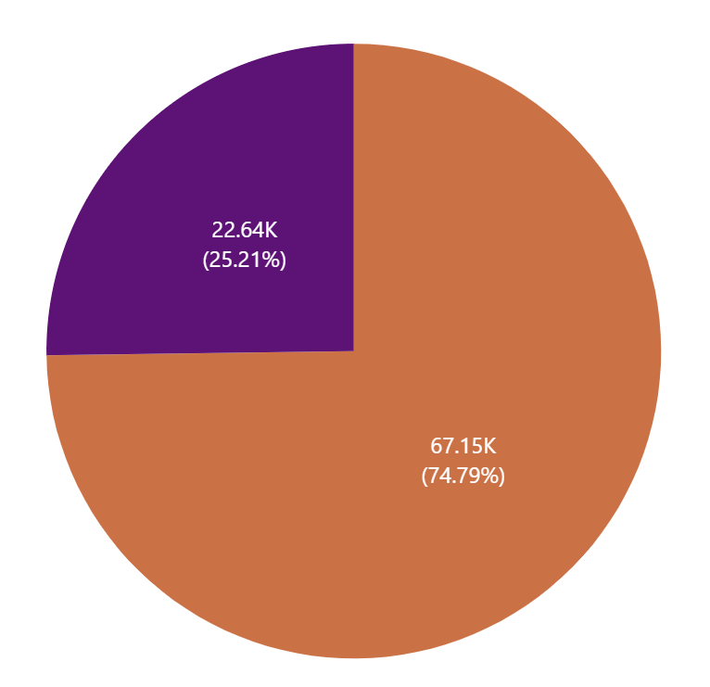
3.1. Target Feature
Conclusion:
Charged off
The chart shows that the amount of fully paid accounts for a large proportion, about 75%. The amount of charged off accounts for 25%
However, this is still a fairly large charged off rate and needs to be resolved.
This is almost an imbalance problem
Fully paid
Fig 7. Target feature distribution

Slide 13
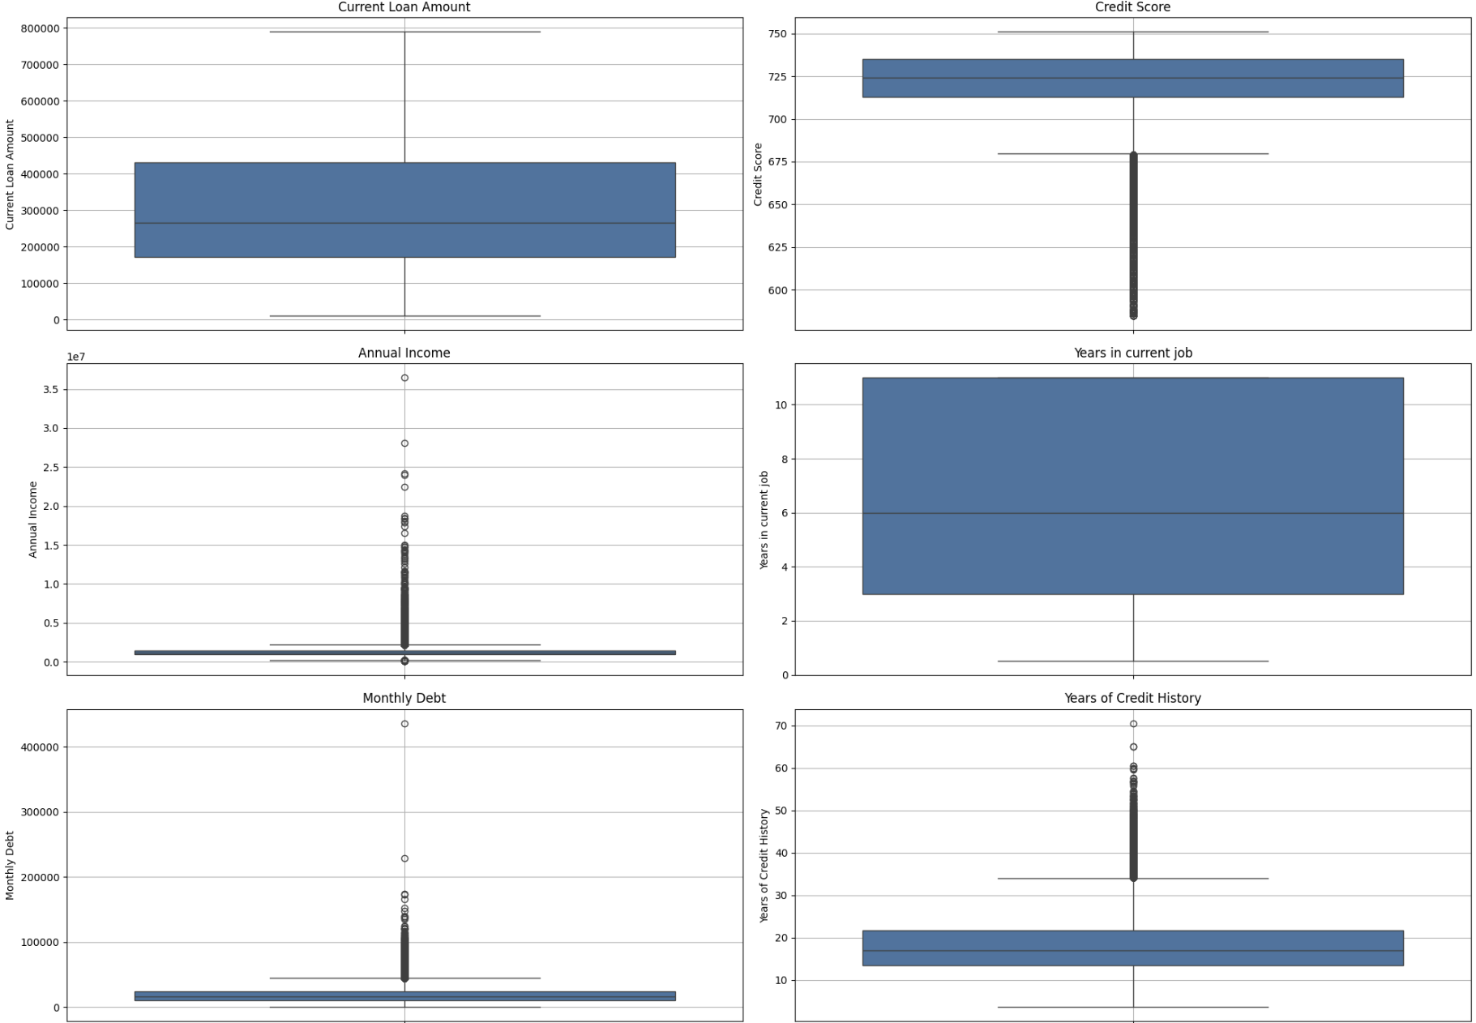
3.2. Numerical Feature
Conclusion:
Current loan amount: Focused in the range of $200,000 to $400,000. It can be said that these are loans of quite small value.
Credit Score: Focus between 710 and 735.
Annual income: ranges from $100,000 to $600,000. There is a small amount of outliers above 1.5M$
Years in current job: Number of years focused from 3 to over 10 years
Monthly debt: focus on less than $25,000. Outliers are concentrated between 50,000 and 200,000
Years in Credit history: Focus on 15 to 22 years. Outliers appeared over 30 years ago. Some outliers are over 60 years old
Fig 8.1 Numerical distribution

Slide 14
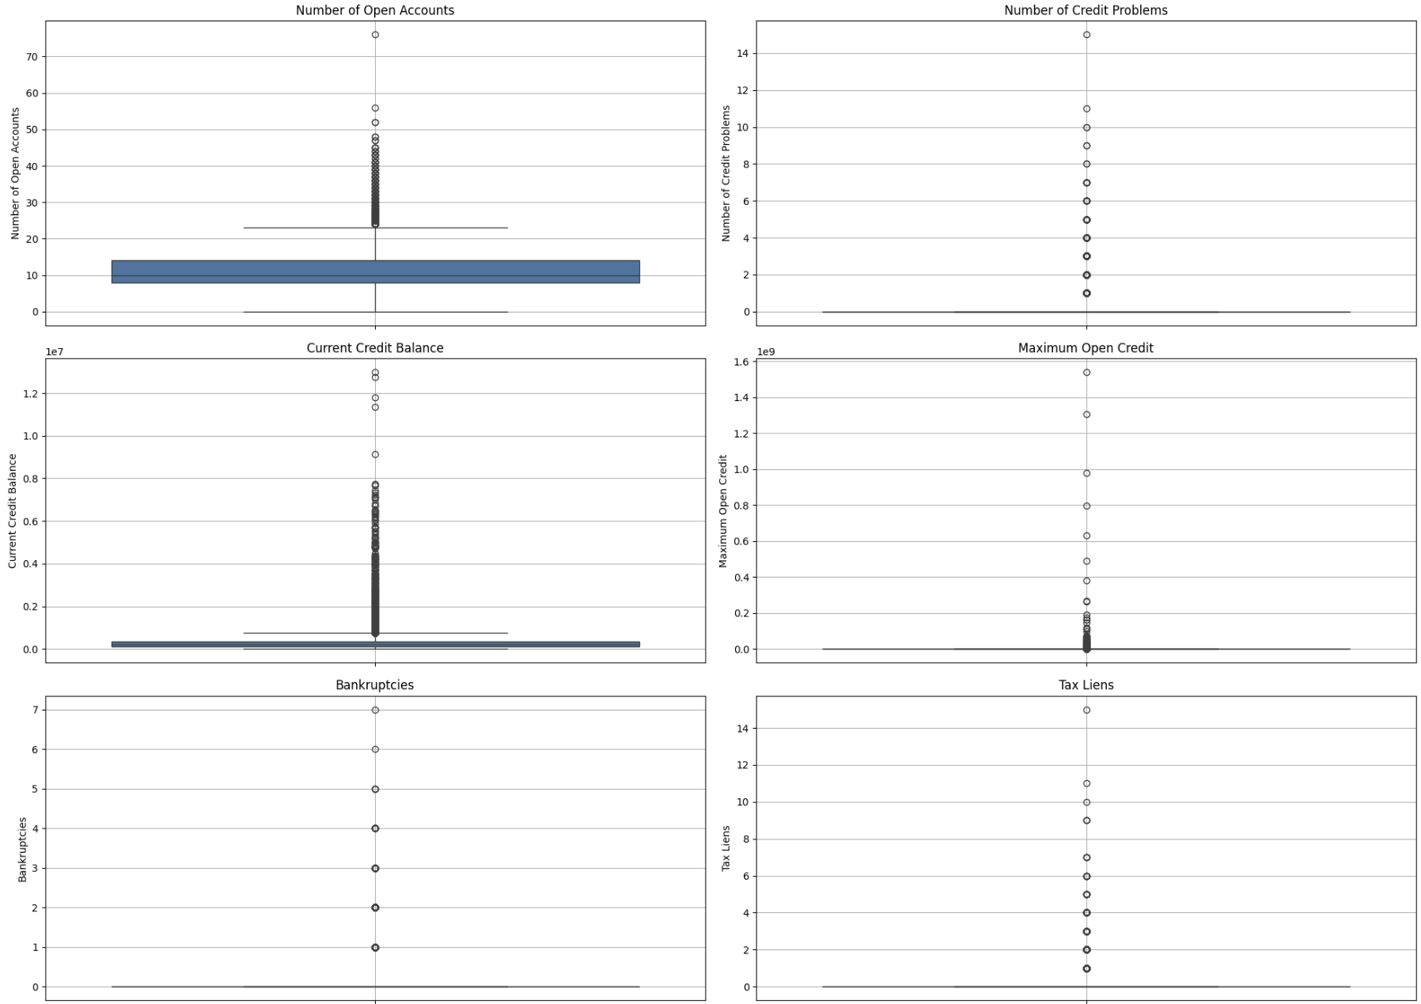
3.2. Numerical Feature
Conclusion:
Number of Open Account: Concentrate from 8 to 15 accounts.
Number of Credit Problem, Bankruptcies, Tax Liens are highly concentrated at 0. It seems that these 3 features are correlated with each other.
Current Credit Balance focuses on the range of $200,000 to $400,000
Maximum open credit is concentrated in the range of 5M$ to 10M$
Fig 8.2. Numerical distribution

Slide 15
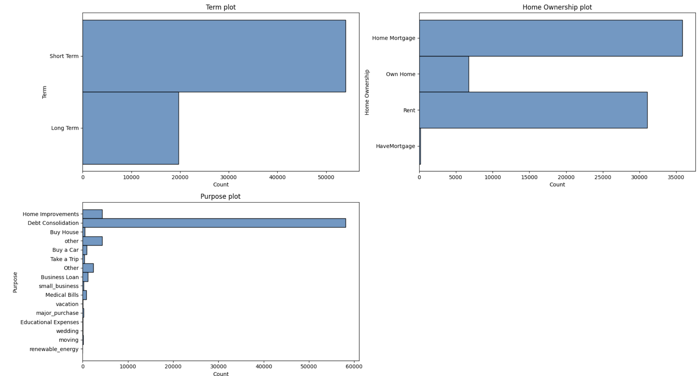
3.3. Categorical Feature
Conclusion:
Term: Short term has 2.5 times more loans than long term.
Home Ownership: Focused on Home Mortgage and Rent. HaveMortgage has the lowest exposure.
Purpose: Most loan purposes are Debt Consolidation (nearly 60,000). The remaining is Home improvement, other(<5000)
Fig 16. Categorical distribution

Slide 16
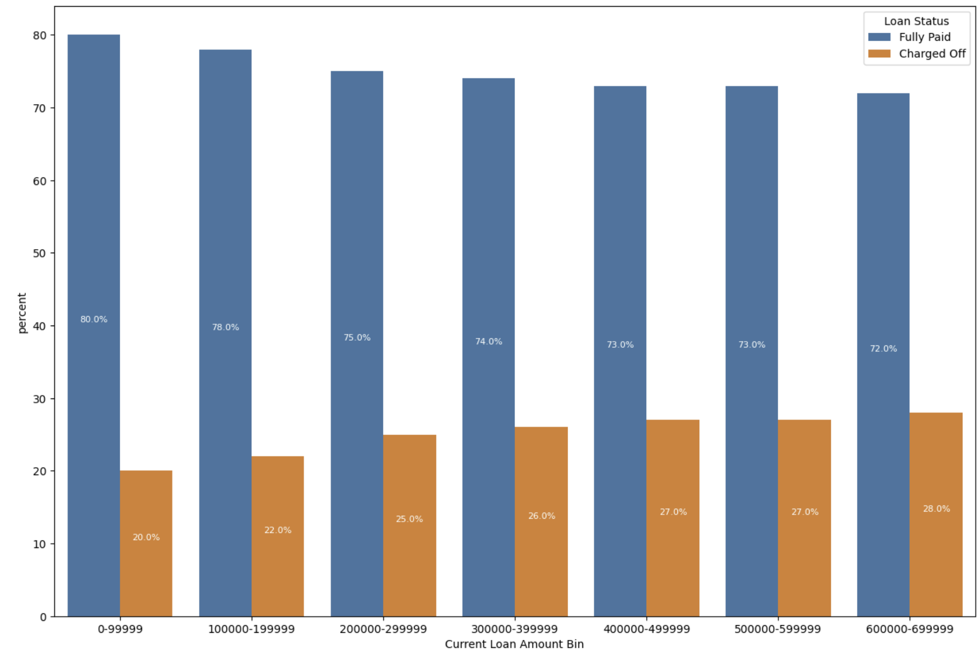
3.4. Insights and Initial Predictions
Insights and Initial Predictions of Loan Status
Conclusion:
Loan Status: - Current Loan Amount: The relationship between the current loan amount and the charged-off rate may be due to:
Poor Repayment Ability
Higher Debt Load:
Stricter Lending Policies
Fig 13. Current Loan Amount & Loan status

Slide 17
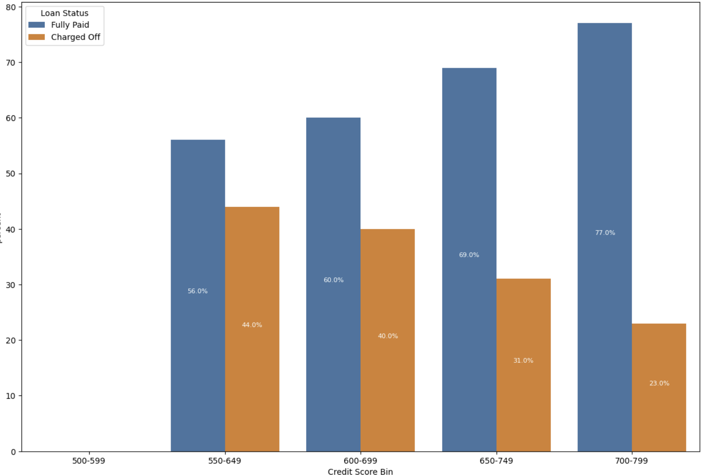
3.4. Insights and Initial Predictions
Insights and Initial Predictions of Loan Status
Conclusion:
Credit Score The relationship between the current loan amount and the charged-off rate may be due to:
According to the chart, we see that the higher the credit score, the greater the density of fully paid compared to Charged Off
The reason comes from:
Good credit history
Strong financial capacity:
Preferential interest rate:
Better loan conditions:
Responsibility mentality:
Fig 14. Credit Score & Loan status

Slide 18
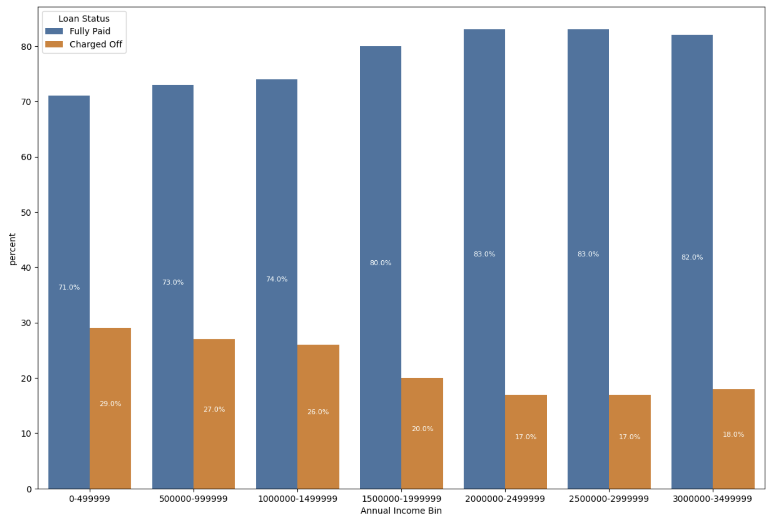
3.4. Insights and Initial Predictions
Insights and Initial Predictions of Loan Status
Conclusion:
Annual Income: The relationship between annual income and the charged-off rate can be explained by:
Better Financial Stability
Financial Cushion:
Stability:
Access to Financial Resources:
Better Loan Terms:
Fig 15. Annual Income& Loan status

Slide 19
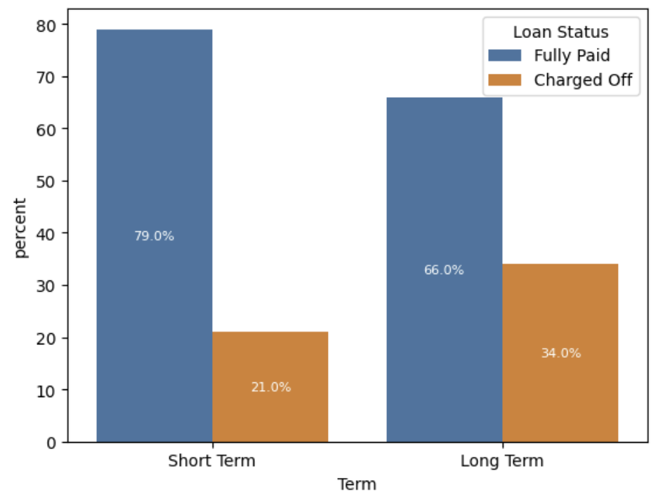
3.4. Insights and Initial Predictions
Insights and Initial Predictions of Loan Status
Conclusion:
Term :
Most loans are short-term loans. The number of short-term loans is 2.5 times higher than long-term.
The Fully paid rate of short-term loans is 4/5
The fully paid rate of long-term loans is 2/3
Short term has lower rate of charged off than Long term
Lower Risk:
Financial planning made easier:
The loan amount is usually smaller than:
Due diligence of the borrower:
Lower debt risk:
Fig 17. Term & Loan status

Slide 20
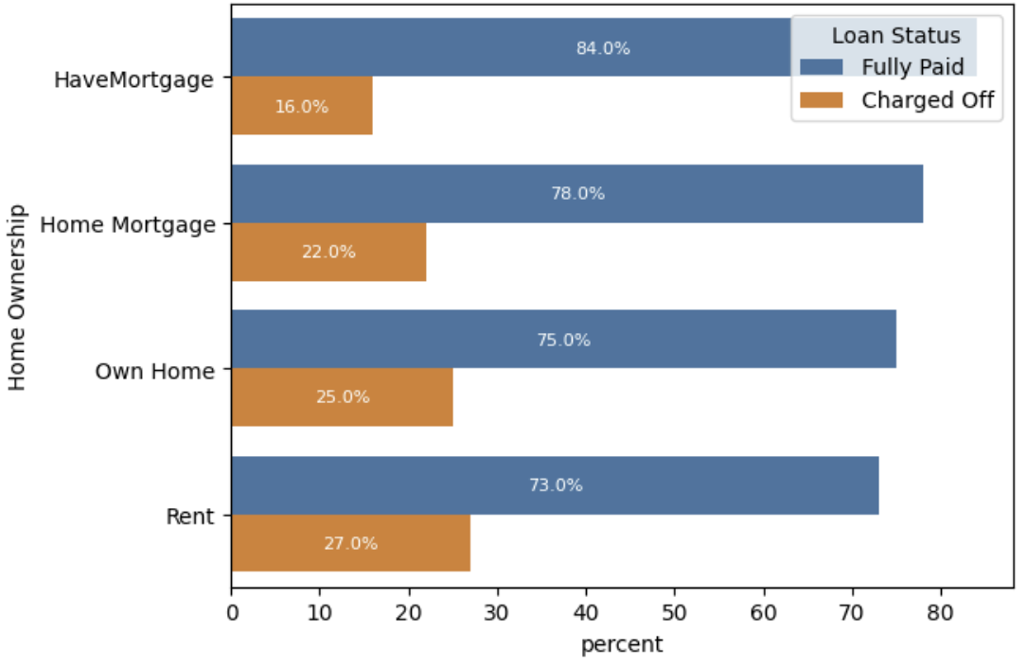
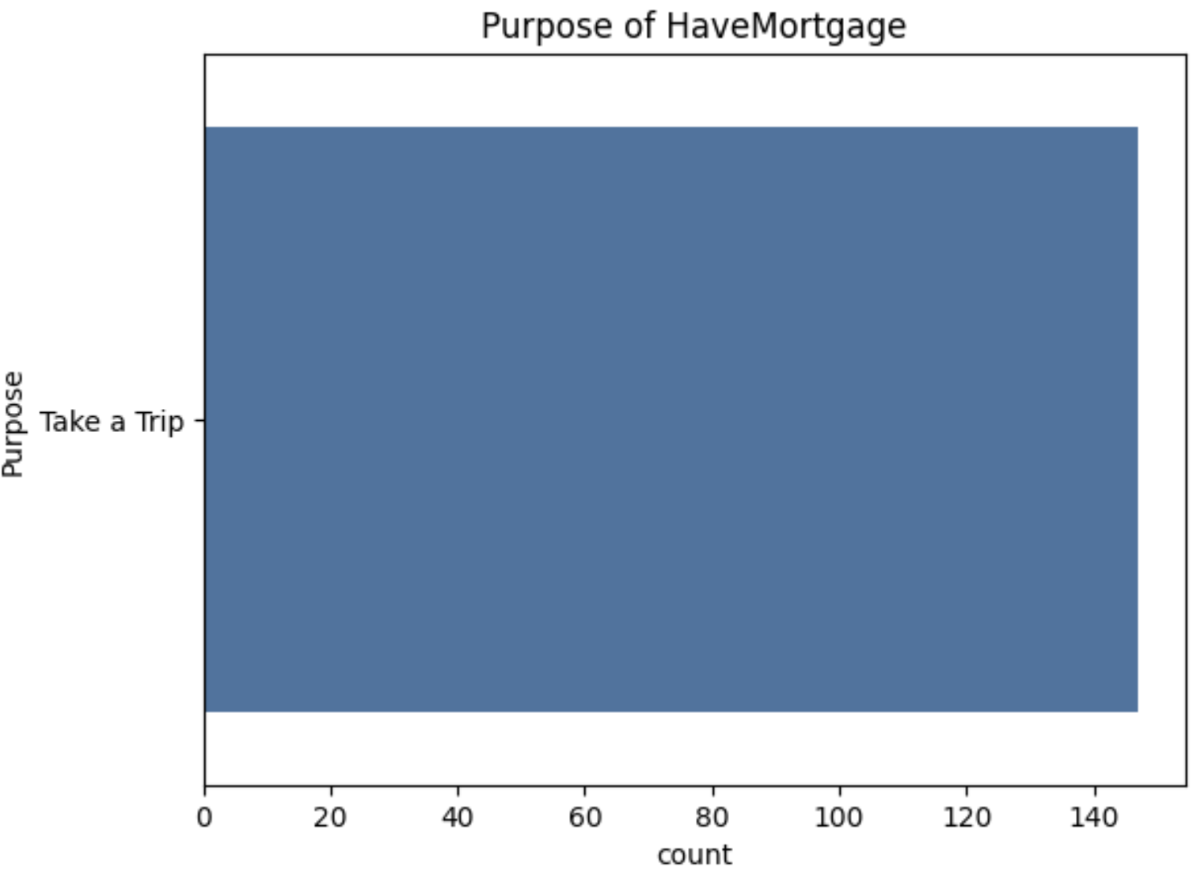
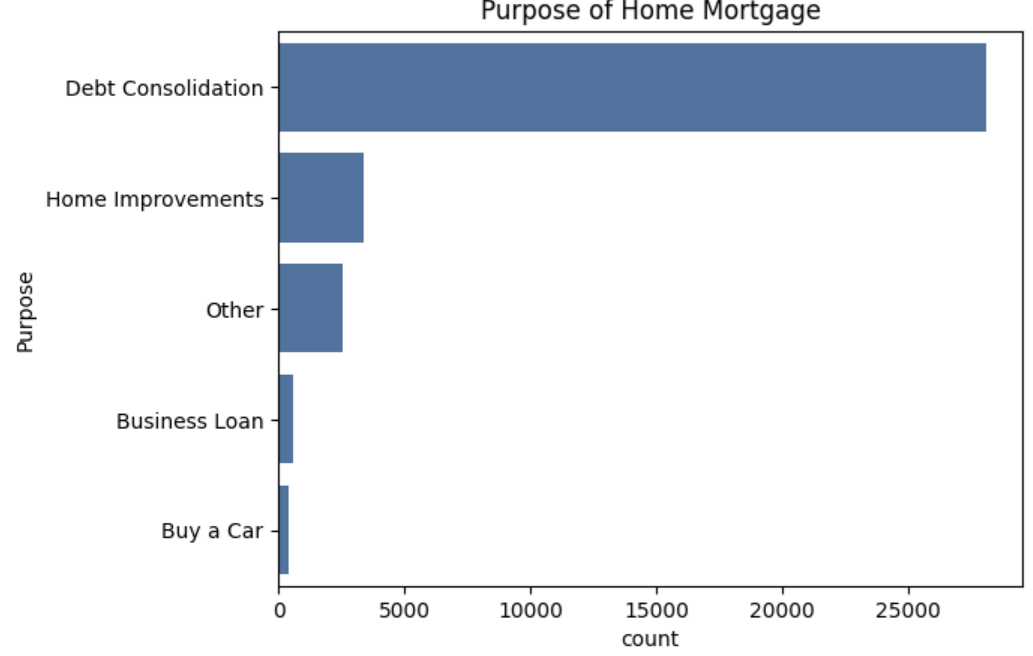
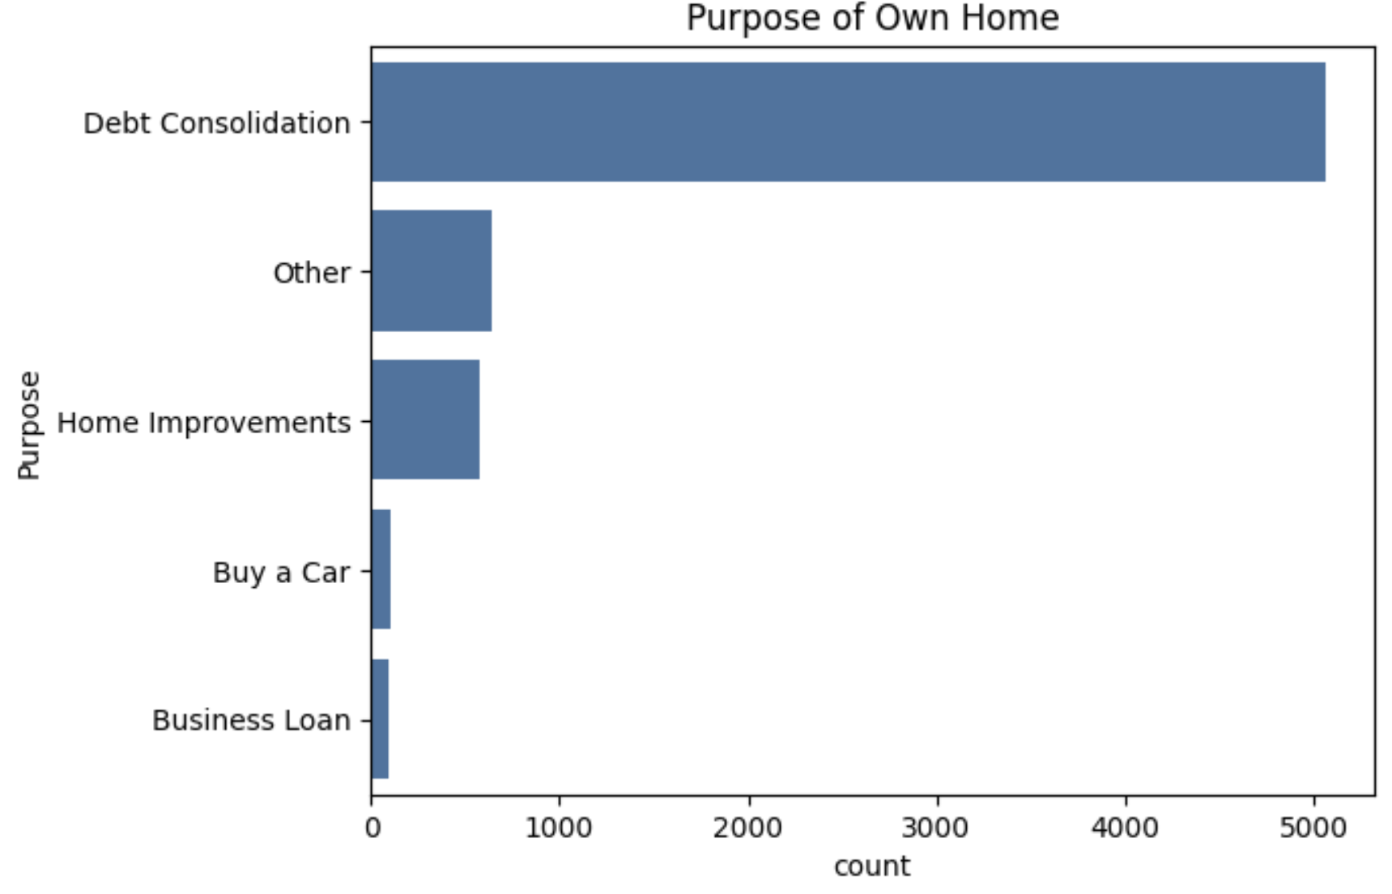
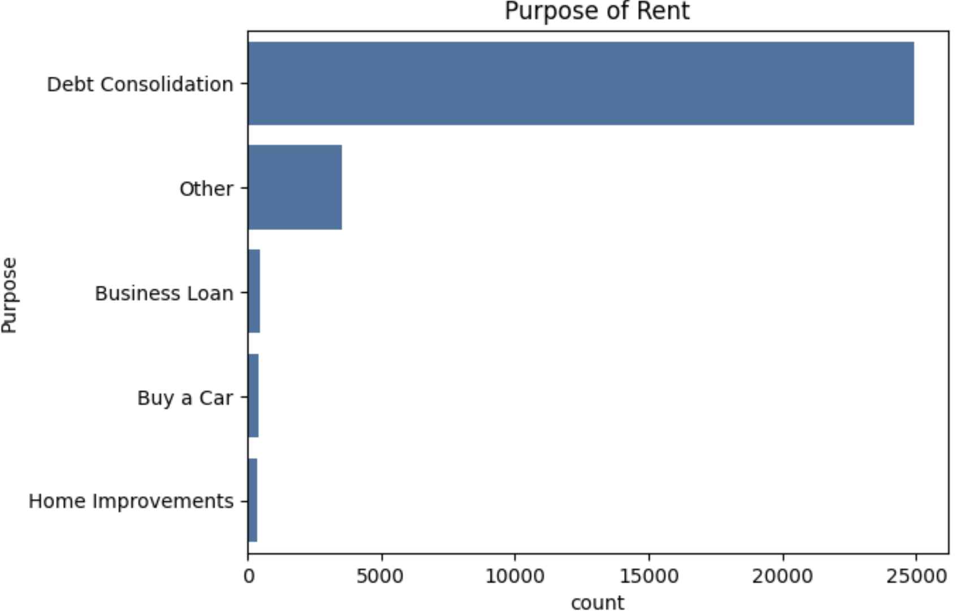
3.4. Insights and Initial Predictions
Insights and Initial Predictions of Loan Status
Home Ownership :
Have Mortgage has lower Chargerd off because off:
Have Mortgage only for taking a trip.
Other loans are more complex, mainly from multiple loans consolidating debt into 1. In addition, these loans appear for the purpose of car loans, loans for financial purposes.
Fig 18. Home ownership & Loan status

Slide 21
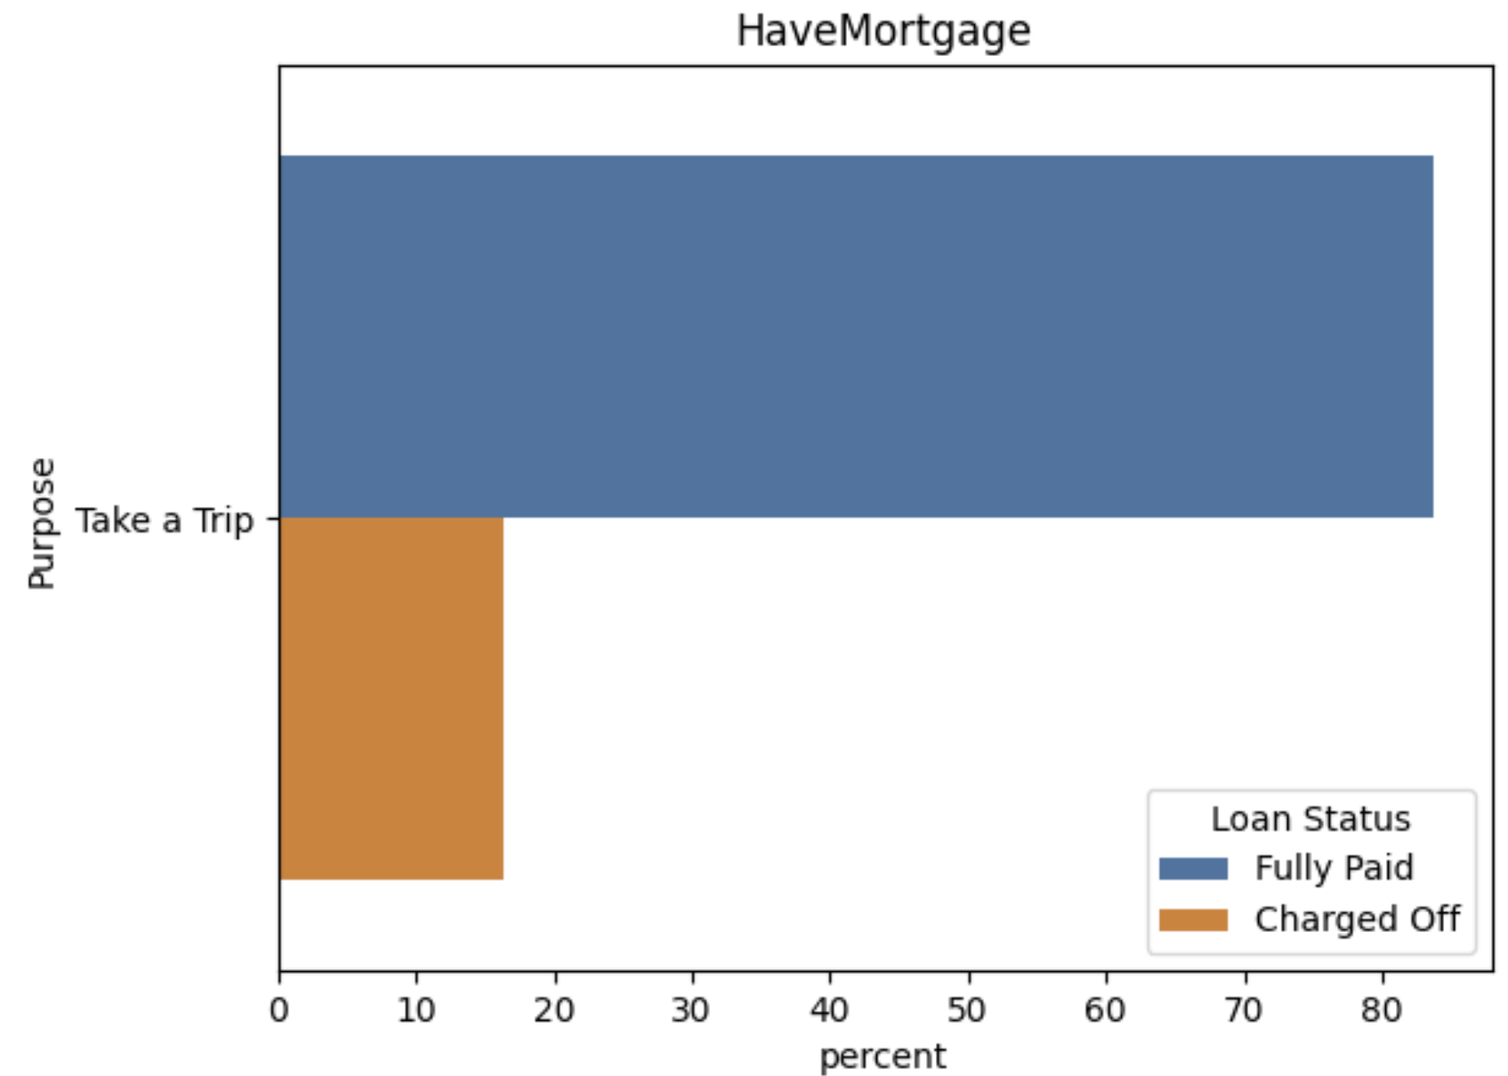
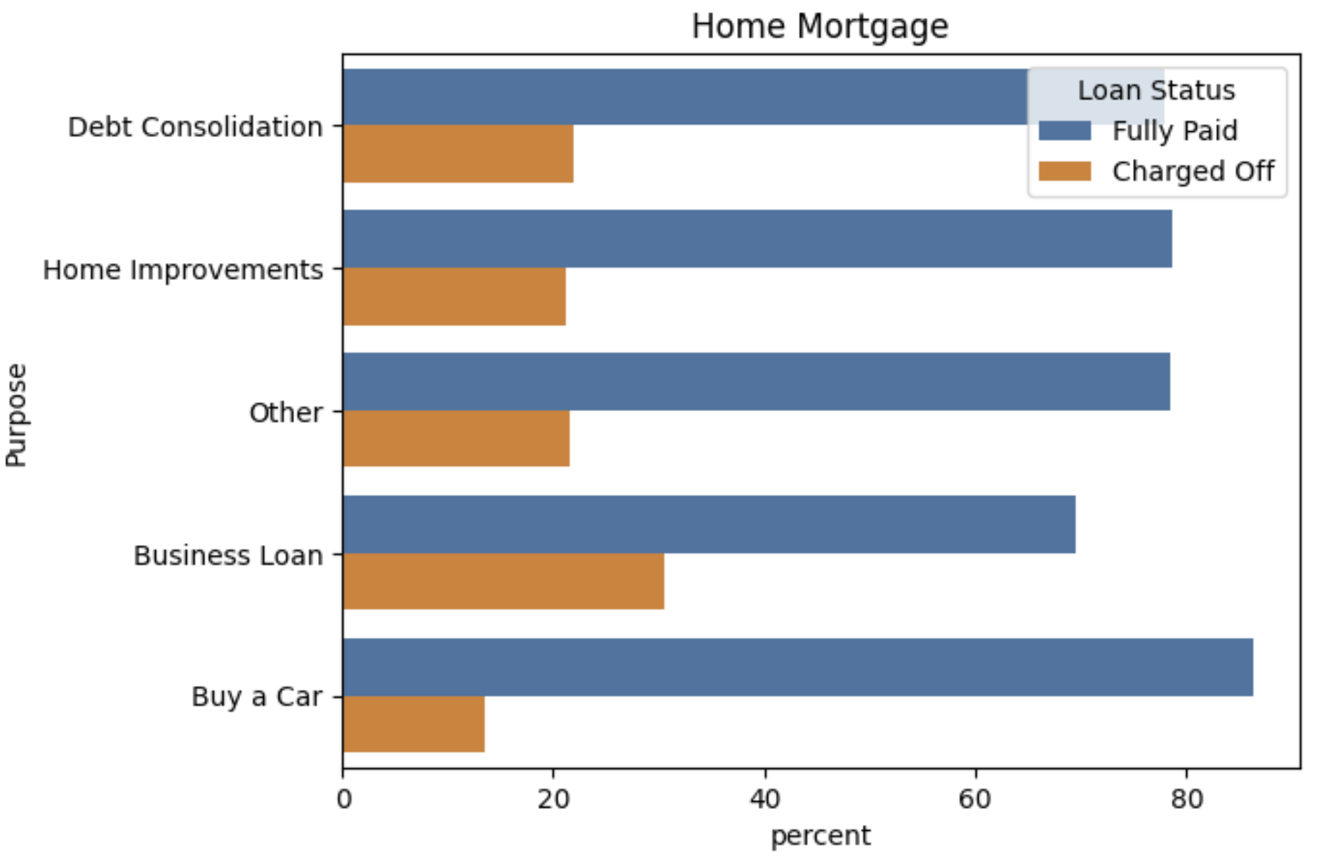
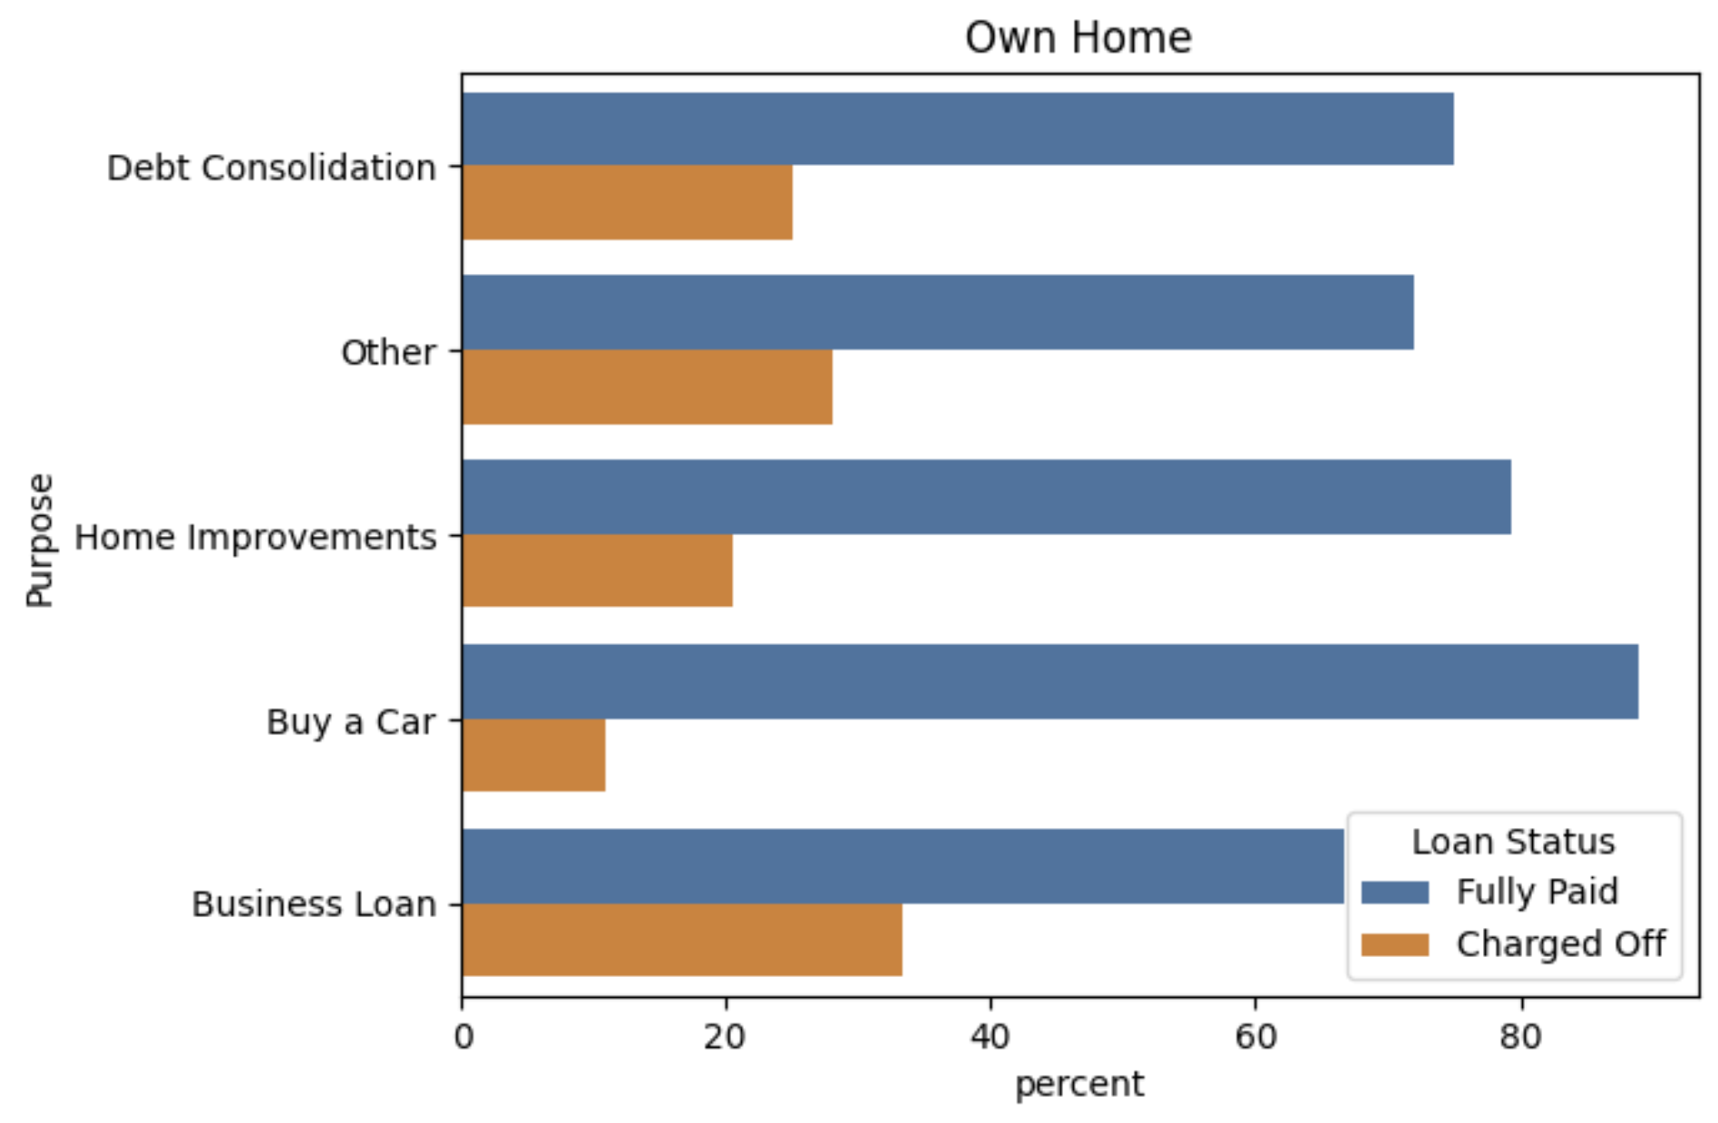
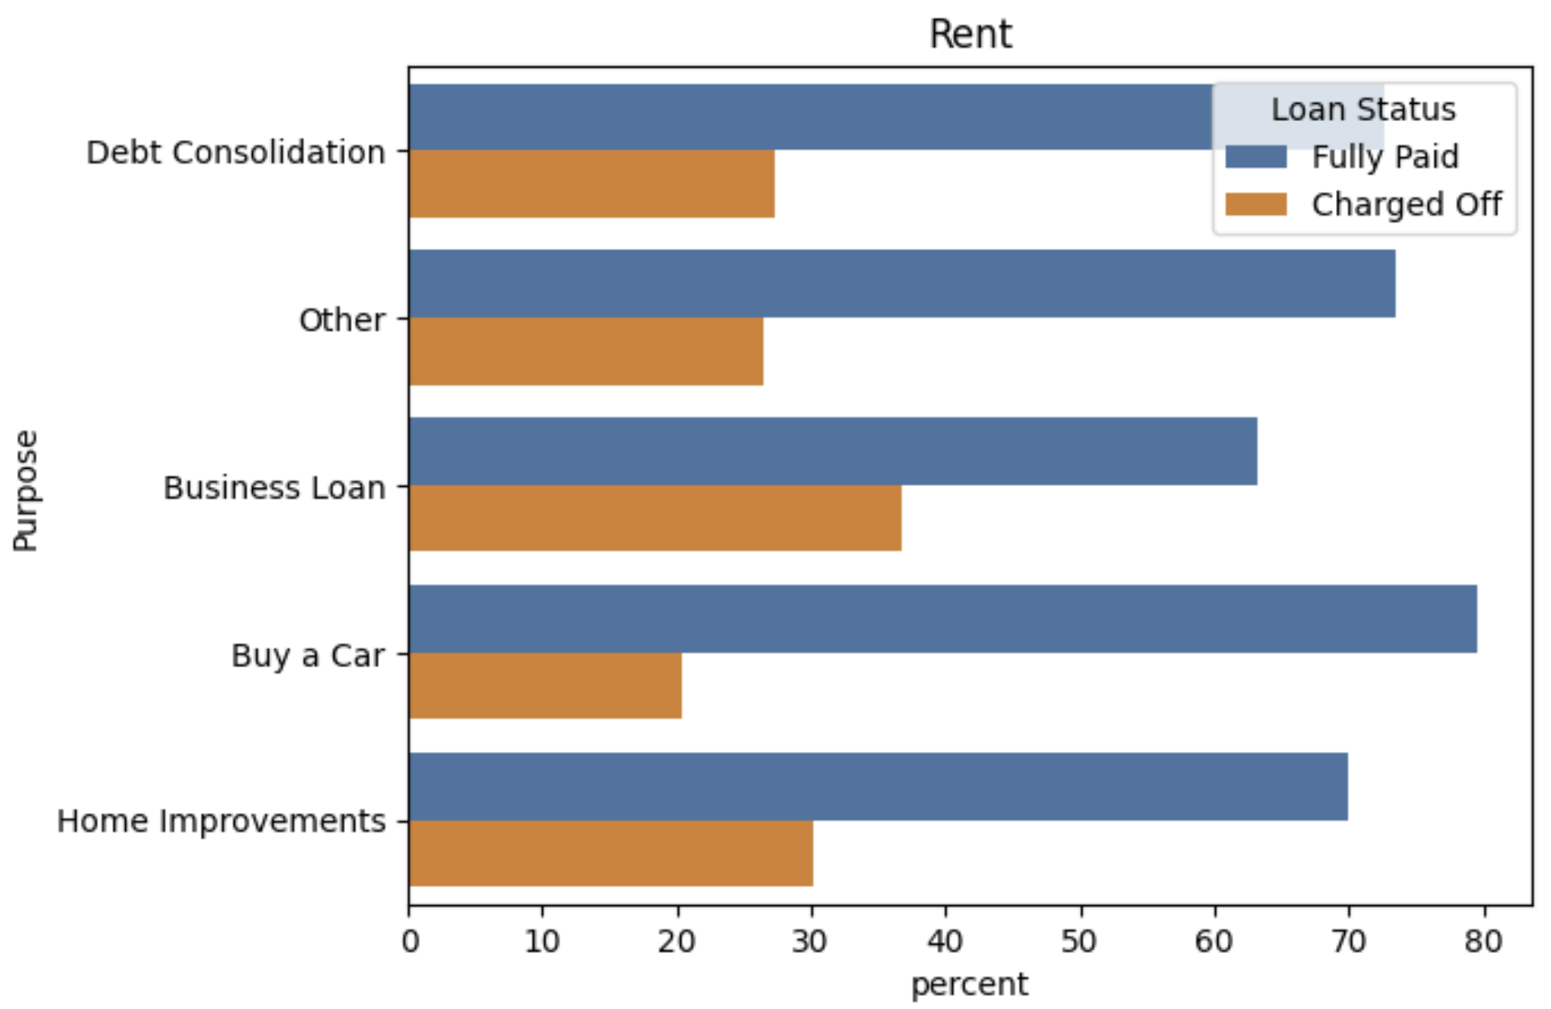
3.4. Insights and Initial Predictions
Insights and Initial Predictions of Loan Status
Fig 18.2 Home ownership & Loan status

Slide 22
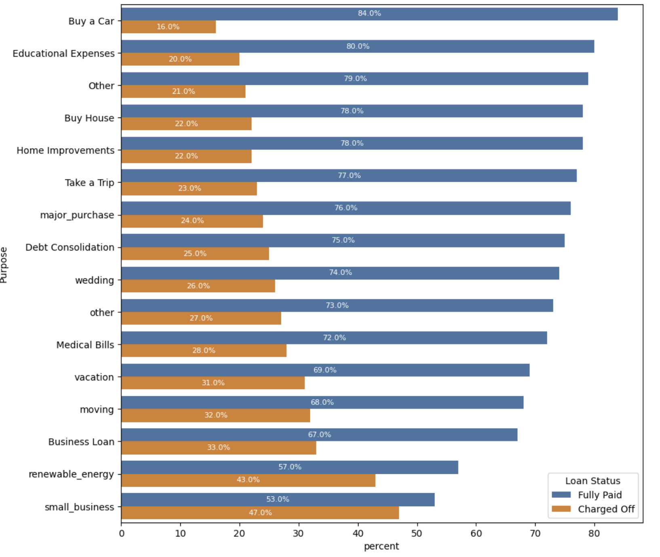
3.4. Insights and Initial Predictions
Insights and Initial Predictions of Loan Status
Conclusion:
Purpose
Small Business and newable_energy are having very high charged off rates. Meanwhile, purposes with a large number such as Debt Consolidation and Other have a much lower rate.
Debt consolidation and other have lower rate of fully paid because of:
Interest rates
Payment is easier
Clear capital use plan:
Less pressure from other debts:
Small Business and newable_energy have higher rate of fully paid because of:
Business risks: (financial, market)
Lack of financial and management resources:
Unstable revenue leads to low liquidity
Limited financial support:
Project risks:
Policy risks:
Fluctuations in raw material and labor prices, market...
Fig 19. Purpose & Loan status

Slide 23
04
Feature Selection & Modeling

Slide 24
4. Feature Selection & Modeling
Model Selection
Feature importance
Select the type of model.
Calculating Performance Metrics
Visualize and select model
Calculate and visualize the feature importance
Model Interpretability
LIME and explanation

Slide 25
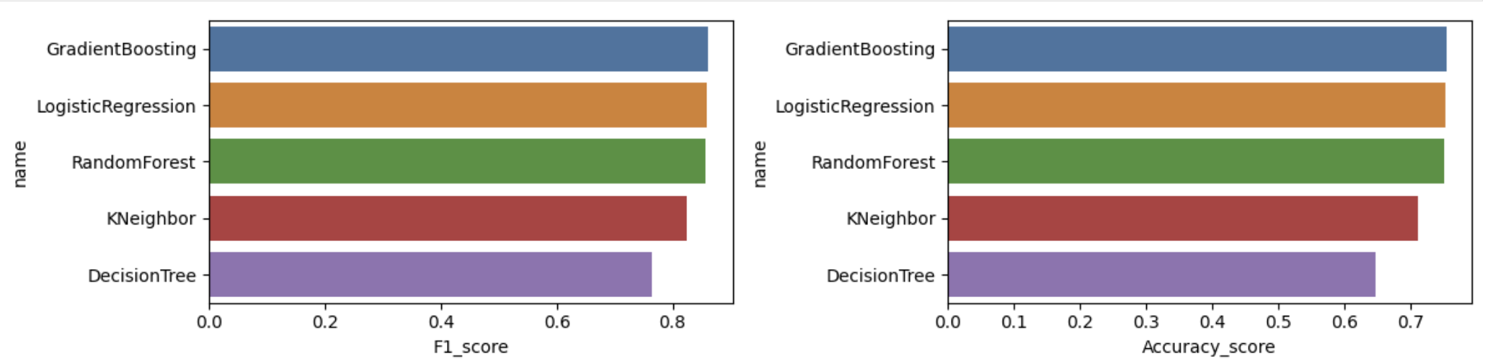
4.1. Model Selection
Fig 20. Model selection plot
It can be seen that the three methods Gradient Boosting, Logistic Regression, Random Forest all have the same and highest results.

Slide 26
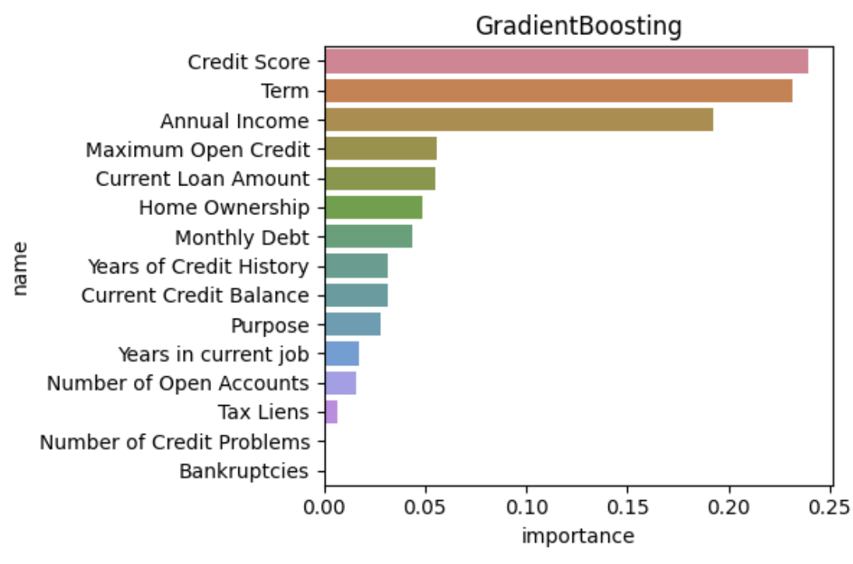
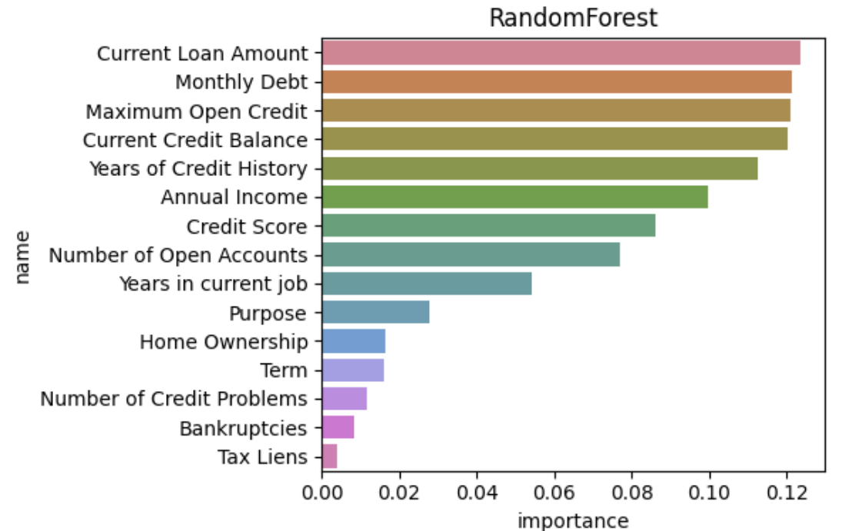
4.3. Feature importance
Fig 21. Importance feature of Gradient boosting classifier plot
Fig 22. Importance feature of Random Forest Classifier plot
According to the three plots, we can see that Current Loan Amount, Credit Score, Monthly debt, Maximum open credit, Term, Annual income are the 6th features that have the greatest influence on the model.

Slide 27
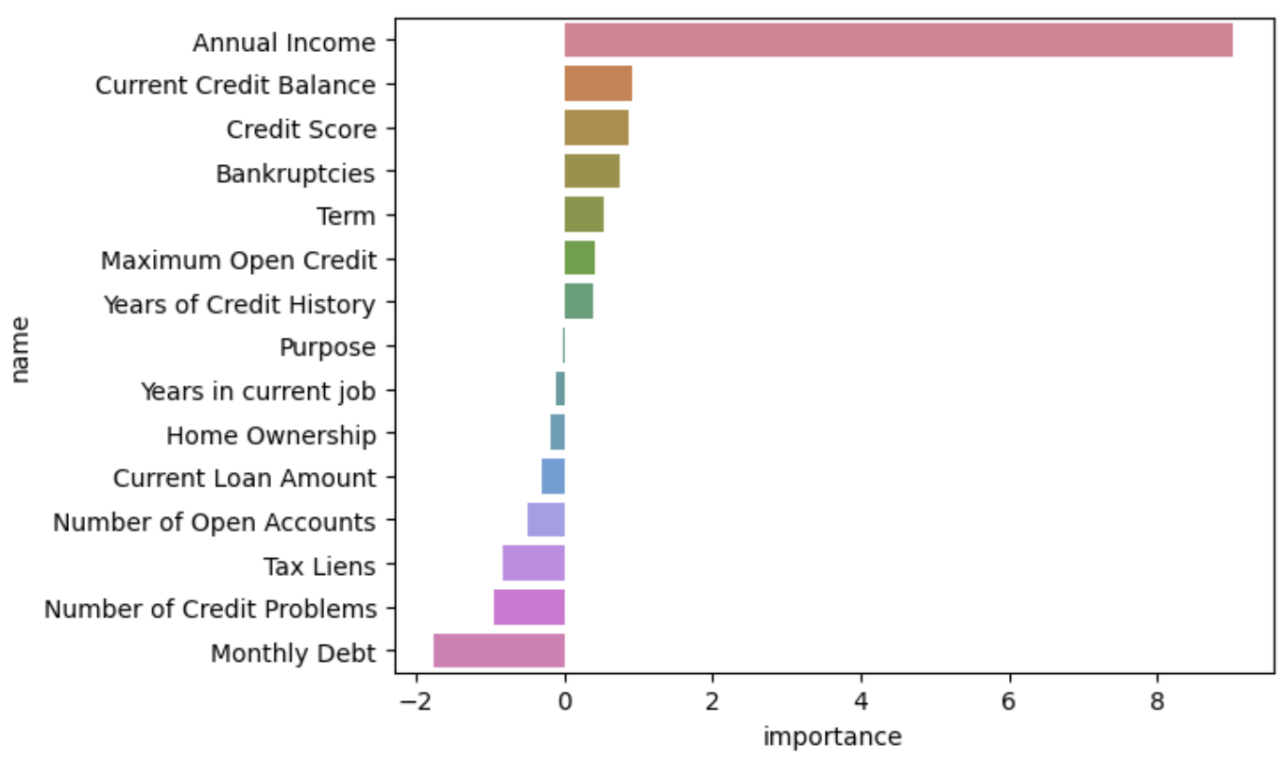
4.3. Feature importance
Conclusion:
Through Logistic Regression, we can see:
Annual Income: The customer's annual income is the most important factor. A large positive value shows that high income has a positive impact on the ability to repay the loan (less likely to be "charged off").
Followed by Current credit balance, credit score, bankruptcies, term…
On the contrary, monthly debt has a negative value, it can be seen that the larger the value, the higher the rate of charged off.
Followed by Number of credit problem, tax liens…
effection
Fig 23. Weight of feature in Logistic Regression

Slide 28
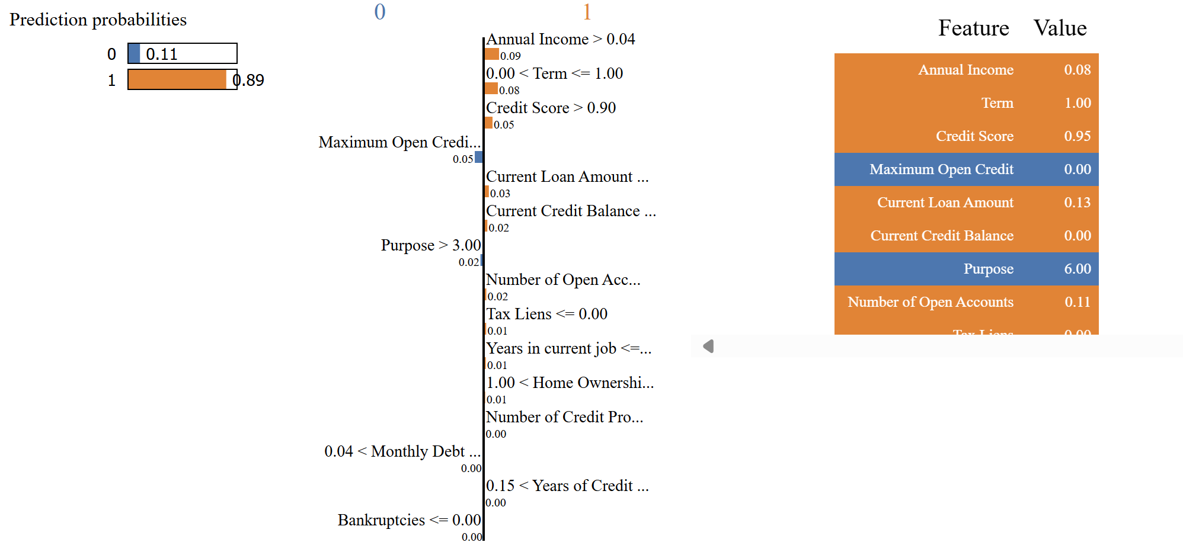
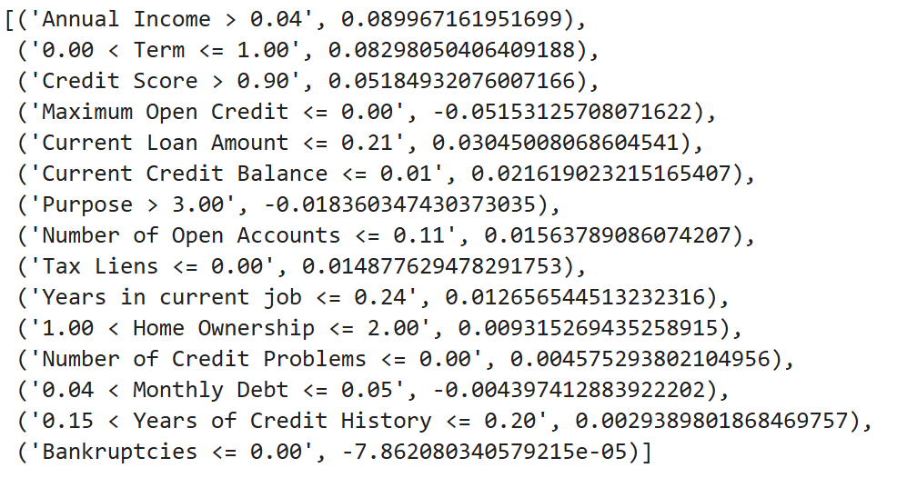


4.4. Model Interpretability
1532579
Short term
735
0
174276
129869
Debt Consolidation
Annual income greater than $153,257 contributes 0.09 to the fully paid prediction
Term is short loan term contributes 0.08 to the fully paid prediction
Maximum open credit equal 0 contributes 0.05 to the charged off prediction
Credit score greater than 735 contributes 0.05 to the fully paid prediction
Current Loan greater than $174,276 contributes 0.03 to the fully paid prediction

Slide 29

4.5. Customer portrait charged off
Customers with high charged off rates will have the following factors:
Highly
Slightly
Monthly debt
Number of credit problem
Tax Liens
Number of open account
Term : Long Term
Annual Income
Current Credit Balance
Credit score
Term : Short Term

Slide 30
05
Recommendation

Slide 31
Thanks!
Do you have any questions?
Namqt.hust@gmail.com
+84 343061414

Slide 32
Alternative resources
Source code : Bank Loan Status Dataset (kaggle.com)

